Slide 1

Microservices Proposal for GE

Slide 2
UST Global
Copyright and Confidentiality Notice
Copyright © 2015 by UST Global Inc. All rights reserved. This document is protected under the copyright laws of United States, India, and other countries as an unpublished work and contains information that shall not be reproduced, published, used in the preparation of derivative works, and/or distributed, in whole or in part, by the recipient for any purpose other than to evaluate this document. Further, all information contained herein is proprietary and confidential to UST Global Inc and may not be disclosed to any third party. Exceptions to this notice are permitted only with the express, written permission of UST Global Inc.
UST Global® is a registered service mark of UST Global Inc
Proposal Identification Number: WELL-1947-01-00
Proposal Expiration Date: Three months from the day of submission
UST Global
20 Enterprise
Aliso Viejo, CA 92656
Tel: 949.716.8757
Fax: 949.716.8396
www.ust-global.com

Slide 3
Project Scope

Slide 4
Why UST Global
Best Solution for Anthem
Built on world class microservices technology stack with holistic IT ecosystem perspectives, such as, architecture foundation, Agile development, DevOps, and Runtime
Balanced architecture and design patterns for highly scalable, highly available, and high performance solution
Platform agnostic solution - Cloud portable and cloud enabled
Centralized external configuration management and configuration are derived from environment
Quality focused – deep testability
Indoctrination on Microservices Frameworks, Tools, Process, and Methodology
Delivers recommendations, code templates, and reference architecture
Experience
UST team has deep experience in microservices architecture
UST knows how to enable successful adoption & consumption at scale, across broad and deep service portfolio
Ability to transfer deep knowledge of microservices into Anthem – help institutionalize architecture practices
Technical SME capability will speed up delivery, ensure quality, and ensure predictability
Learning from past projects leveraged for proactive, preventive issue/ risk mitigation
Right blend of technical and domain experience to partner with Anthem in driving future state
Mature DevOps practice
Leading-edge 3rd generation Agile practices – consulting & training offerings for successful Agile delivery engagement
Relationship
14+ years strategic relationship with Anthem
Deep understanding of Anthem’s business & initiatives
UST teams already involved in Anthem development & maintenance
Portal areas
Provider services
Enterprise Services
SOA testing
Mobility
Claims platforms

Slide 5
Phase I Scope
UST Global’s comprehensive solution includes:
Architecture consulting
Foundational readiness
Development & Testing on in-scope microservices
Agile consulting
Recommendation of DevOps platform to enable:
Configuration management
Build automation
Test automation
CI/CD automation
In Scope
Microservices Design, Implementation, & Validation
SearchByID
GetMemberContactInformation
GetMemberPreferences
GetMemberEligibility
UpdateContactInformation
UpdateMemberPreferences
UpdatePCPInformation
GetMemberCDHPAccountInformation
Get Temporary ID Card
Get Indices
Send ID Card via Email/Fax
Duration
18 weeks
Out of Scope
Service Data Stores (SDS) implementation
Application migration process
Service Virtualization
API management
Data lakes
ESB
Enterprise services
Teams
1 Foundational Readiness team
2 fully staffed, cross-functional implementation teams

Slide 6
Phase I Foundational Readiness Activities
Define Microservices Architecture Architecture Repository Development Standards Tools & Frameworks Performance Architecture Security Architecture Testing Architecture CI/CD Architecture Operational Architecture Create Microservices Reference Implementation Frameworks & Tools Integration Essential Configuration Code Templates Patterns & Practices Recommend CI/CD/DevOps for Microservices Environment setup and configuration SCM infrastructure CI/CD toolchain & pipelines Build/deployment automation DevOps toolchain & pipeline | Establish Quality Management Foundation Unit Testing Tools Integration Testing Tools E2E Testing Tools Performance Testing Tools Code Quality Management Tools Phase 1 Implementation Team Readiness & Ramp-up Indoctrination on Microservices Frameworks, Tools, Process & Methodology Agile team tools setup (JIRA, Confluence) High Level Sprint Planning, Backlog grooming, Sprint Dashboard creation Requirements/Acceptance Criteria definition & refinement for early sprints High Level Analysis, Design, and Test Planning for early sprints
UST will create a Cookbook (instructional manual, lessons learned), to be leveraged and updated during the implementation of additional microservices in later phases.

Slide 7
Pricing
Phase I, Option 1 (recommended):
UST will design, implement, and validate all features in phase 1 scope
Includes:
Foundational readiness
Recommendation for DevOps
11 microservices in a period of 18 weeks (assuming all dependencies are addressed on time)
Fixed fee of $1,125,000
Price includes an initial 6 weeks of foundational readiness effort as needed to enable highly effective Agile microservices delivery, to include
Architecture consulting services
Agile consulting services
Environment preparation
Establishment of configuration management
Establishment of build automation
Key Benefits
Highest level of cost predictability and scope control
UST owns all responsibilities and risks
Efficiency gains shared with Anthem
Includes Foundational Readiness
Phase I, Option 2
Time & Material staffing model
UST Global will staff positions based on Anthem’s needs
End to end responsibility for project management and delivery will be with Anthem
UST Global will share outcomes and risks
Mutually agreed efficiency gains with associated rewards/penalties
Phase II
Scoping & pricing for the remaining 489 microservices will be finalized at the end of phase 1 as a “fixed fee per service implemented” model with guaranteed productivity improvements.
Total fee (estimated)
$11M - $14M with a hybrid (onsite and offshore) model
$17M - $21M if an onsite only model is required
Assumption: 2 years duration for Phase II

Slide 8
UST Global Microservices Solution Overview

Slide 9
UST’s Strategic Approach to DevOps
Approach
DevOps is more than technology; Biggest bottlenecks may not be technology and toolset
Strategic Assessment
Process Adjustment
People
Train Teams
(Agile 3.0)
Process
Continuous Refinement
Policies
Tools and Automation
Institute Policies and Governance
Technology

Slide 10
Maturity Assessment Process
DevOps Maturity
Current state Assessment and Desired State Goals
Prioritize and Define
Implementation Roadmap
Team Alignment and Education
Capture Current state of processes, technology, teams Structure
Outline specific improvements to current process, technology, policies
Organization alignment on desired state on process and technology
Assess Complexities, user value
Use well defined weighted approach to prioritization
Define maturity priorities
Leverage UST DevOps Practices and Solutions
Identify key measurable milestones
Outline Framework for Pilot/Phase I
Values and outcomes
Collaboration process
Assumptions and Risks
Define higher level roadmap for pilots, Services/Apps
Detailed roadmap with implementation plan

Slide 11
Assessment Workshop
Workshop
Audience:
Key stakeholders, leadership, architects, and product owners
Delivered Value:
Clear recommendations for achieving better DevOps maturity,
Adaption roadmap and
Initial architecture
Specific Activities:
Assessment and planning engagement with teams
Detailed discussions & white boarding
Existing tools/technology pros & cons assessment
Specific Deliverables:
Current state capture
Desired state and recommendations
Roadmap
People:
Two UST DevOps consultants

Slide 12
Typical Assessment Questions
Maturity Methodology
Develop and test:
Do all developers and testers understand the release criteria?
Can teams create production application configurations in development and test environments?
Can developers self-service provision infrastructure?
Release and Deploy:
Can your teams deliver current tasks and timelines to stakeholders?
Are your release deployments automated from development, testing to production?
How many change board approvals within a release?
Operate and Evaluate:
Have applications and services moved to third party cloud services?
Have your teams understand the need for continuous delivery?
Can your teams monitor complete business services and report to end users whether they are green, yellow or red?

Slide 13




Continuous Innovation delivered as-a-Service (CiS)
CiS
Agile Program Management
Planning
Design
Configuration and Implementation
Policies
People
Continuous Innovation
FogPanel Cloud Mgmt
Service Mgmt & Infra integration
App.Data.Env-as-a-Service Platform
Federated cloud mgmt and orchestration
Process
Tools
Release and Deployment
Testing Tools Integration
Test Data Management
Notes:
HMS: Please refer to comments on slide 6.

Slide 14
UST Microservices Solution for Anthem
Solution Highlights
Architecture
Operations
UST Execution Model
Tools & Frameworks
Event Logging
Agile Execution Model
Centralized Configuration
Instrumentation
Foundational Readiness
Event-Driven Architecture
Monitoring
Reference Implementation
Service Registration
Automation
Patterns & Practices
Service Discovery
Test Automation
Program Management
Smart Service Client
Build Automation
Project Governance
Reactive Services
Deployment Automation
Packaging & Deployment
Self-Service Provisioning
System Qualities
Performance
Scalability
Availability
Security
Cloud-Ready

Slide 15
UST Microservices Solution for Anthem
Capability Product Mapping
Capability | Product
Java - Foundationals
Core Foundational | Spring Framework
IoC Container | Spring IoC
Enterprise Integration | Spring Integration
Relational ORM | Hibernate
Advanced Persistence (NoSQL, Big Data) | Spring Data
Aspect-Oriented Programming (AOP) | Spring AOP
Runtime | Java EE 7
Dependency Management | Maven
IDE | Eclipse
Capability | Product
Java - Microservices Foundationals
Core Cloud (Abstraction, Autoconfig & Binding) | Spring Cloud
Microservices Framework | Spring Cloud Netflix (Spring Cloud core implemented via Netflix's OSS components)
Service Registration & Service Discovery | Eureka
Circuit Breaker | Hystrix
Declarative REST Client | Feign
Client Side Load Balancer | Ribbon
External Configuration | Archaius (based on Apache Commons Configuration)
Routing & Filtering | Zuul
Reverse Proxy | Zuul
Log Aggregation | Turbine
Capability | Product
Java – Security
Core Security | Spring Security
OpenID | Spring Security Core
OAuth | Spring Security OAuth
SAML | Spring Security SAML Extension
Capability | Product
Java - Testing
Test Development | Spring Test
Test Execution Environment | Junit

Slide 16
SME Profiles
Name | Profile
Dave Cheema, CITA-P, MCA, SCEA, Enterprise Architect | More than 30 years of data processing experience as a consultant in a variety of industries Enterprise architecture experience in strategy, design, evaluation, and integration Experience business strategy and IT systems alignment Experienced in delivering large, mission critical applications Experience across multiple platforms, technologies, methodologies, frameworks, design patterns, and languages
David Lazar | Chief architect with WebMD Health Services Built WebMD’s flagship product called Health Concierge, equivalent of "Google" for healthcare information Authority with deep experience within health care technology on microservices, Domain Driven Design, Event Driven Architecture, cloud enablement, and 3rd-generation Agile practices, DevOps Worked directly with and for Marty Abbott of AKF Partners, the world's foremost authority on scalability and availability UST's go-to security guy, having spent 15+ years in that world as a consulting chief architect in information security for American Express, Wells Fargo, and JPMorganChase.
Sanu Mary Varghese, Solutions Architect | More than 10 years of IT experience 6+ years of experience in healthcare domain (Anthem Inc, formerly WellPoint Inc) Experience business strategy and IT systems alignment Experienced in delivering large, mission critical applications
Govind Rangasamy, VP, Cloud and DevOps Practice | More than 18 years of software development, product management & marketing, Product strategy, thought leadership and evangelism, Business Development Most recently - CEO of FogPanel, Cloud Orchestration and Governance platform which was sold to UST Global Led DevOps, Test/Dev & Cloud Service Provider products & solution for Actifio
Venki Pan, Enterprise Architect | More than 23 years of IT experience 5+ years of experience in healthcare domain (Anthem Inc, formerly WellPoint Inc) Experience business strategy and IT systems alignment Hands on expertise in delivering large, mission critical applications($53M)

Slide 17
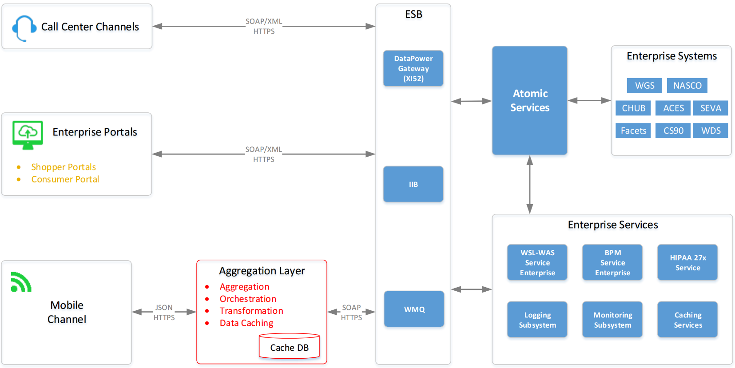
Current State Architecture

Slide 18
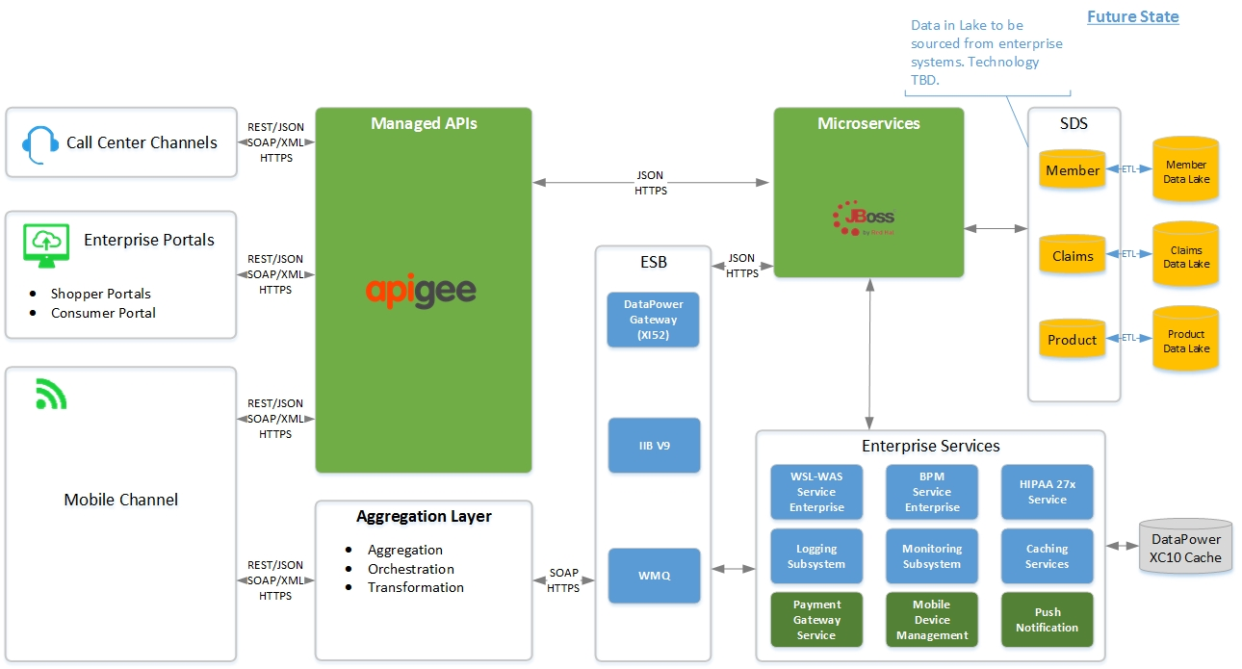
Future State Architecture

Slide 19
Tools & Frameworks
Spring Cloud Supports on-premise, private cloud, hybrid cloud deployments Enables seamless portability to cloud Provides Distributed/versioned configuration Service registration and discovery Routing Service-to-service calls Client-side Load balancing Circuit Breakers Global locks Leadership election and cluster state Distributed messaging Spring Boot Tackles dependency complexity Pre-packaging of all dependencies Spring Environment abstraction layer flattens environment & config data into properties

Slide 20
Centralized Configuration
Environment-driven Configuration Ensures that microservices can be developed & tested locally, then deployed without changes Encapsulates conditional configuration Allows injecting configuration into microservices Centralized, external configuration management backed by source control repository (Git, SVN, etc.) Supports encryption of properties Client library/plug-in obtains config from server Application configuration can automatically refresh whenever centralized configuration changes Management endpoints (REST API) Load/Reload config from external sources Bind/Rebind config properties Refresh configuration into microservices

Slide 21
Event-Driven Architecture
Optimization tradeoff: scalability/availability vs. consistency
ACID problem: doesn’t scale well - distributed transactions, locks, & 2-phase commits limit throughput
BASE solution:
Moves data constraints from the database into the application
Achieves improved availability and scale by relaxing consistency
Event-driven Architecture
Loosens coupling, allowing microservices to evolve independently from each other
Based on principles of Domain-Driven Design (DDD)
Data and functionality are partitioned into business-focused “domains”
Consistency can be enforced within, and across, domain boundaries
Using transaction-less coordination between services
All changes to data are stored as a series of events
Data changes are replicated as events (pub/sub) between domains
Data changes are performed in-sequence
Enables long-term auditability
Can query events and reconstruct past states
Event
Event Listener
Receive
Analyze
Process
Event Engine
Subscriber
Subscriber
Subscriber

Slide 22
Service Registration & Service Discovery
Service Registration
Microservices register themselves with a service registration server
Each service registration server instance is also registered
Each microservice maintains a list of its own dependencies in the environment
Service Discovery
Services can discover each other using environment-based configuration
Clients can discover registered services using simple Java annotations
Clients can discover set of available instances for a particular service using Spring-managed beans
Service Registry
Service Requestor
Service Provider

Slide 23
Smart Service Client
Problem:
In a large collection of services, some instances may be non-operational at any given time
Building in resiliency & stability is essential
Solution: Smart Service Client
Performs lookups of available service endpoints
Incorporates service discovery functionality
Ensures high-availability & performance best practices are followed consistently across microservices
Supports resiliency patterns from ReleaseIT!
Client-side load balancing
Circuit-breaker pattern
Provides transport protocol flexibility
Traditional
REST over HTTP (asynchronous or synchronous)
SOAP over HTTP (asynchronous or synchronous)
Pub/sub
Binary transports
Google's Protocol Buffers
Apache Thrift
Avro
Simple Binary Encoding
All HTTP REST API calls between microservices should go through the smart services client layer

Slide 24
Reactive Microservices
Entire architecture designed to be asynchronous, from top to bottom
Browser
Web Layer
API layer
Integration Layer
Microservices
Inter-service Communication
Dependency consumption
Maximizes scalability, responsiveness & resiliency
Enables easily creating asynchronous, event-driven programs
Built on Spring Reactor
Non-blocking (threads never block waiting for responses)
Reliable message-passing ensures events are received and processed downstream
Flow control ensures receiving side isn't overwhelmed with events

Slide 25
Packaging & Deployment
Packaging is accomplished using Maven or Gradle, with corresponding CI/CD plugins to deploy and manage apps.
Each microservice can have its own, separate
SCM repository
Dependencies
Manifest
CI/CD pipeline
Packaging for Local Development
Large .JAR files, containing:
Code, frameworks, & dependencies
Embedded application server
Packaging for Deployment
Lightweight .WAR file
Just the code, frameworks, & dependencies
Does not include the application server binaries

Slide 26
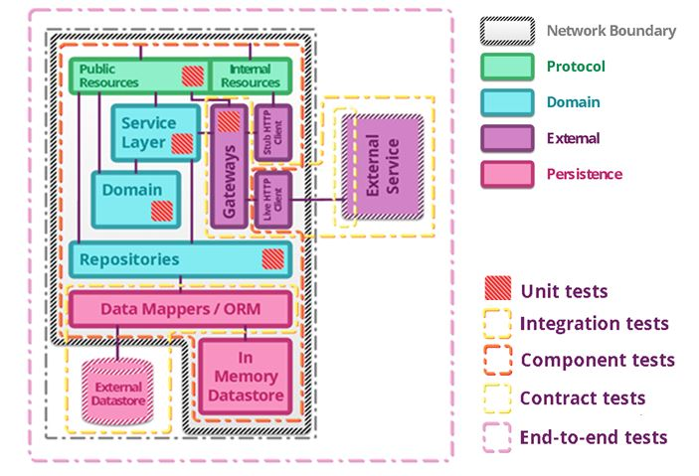
Testing
Unit Testing
UST approach uses wiremock framework
Provides direct support for Junit, using @Rule
Integration Testing
UST approach uses Spring Boot’s @IntegrationTest and Spring’s TestRestTemplate
Provides means of functionally interacting with RESTful services for integration tests
Same container used for developing, testing and production
Consumer Driven Contract (CDC) testing
Highly effective supplement for integration tests
Can be placed in each service’s build-and-deploy pipeline
Far-downstream dependencies or services can be stubbed out
Soap UI 5.1.3 will be used for testing of REST based microservices
Performance, High Availability & Scalability Testing
Availability and scalability testing can be integrated directly into the build-and-deploy pipeline
Can leverage traditional enterprise perf engineering tooling (e.g., LoadRunner)
Can also leverage tools such as Netflix’s simian army
Phase I QA Scope
Testing of the 11 new microservices identified as part of Phase I which are developed using DAL approach
Testing services in SIT/UAT along with PROD Validation on non-update operations
Testing of each backend separately for all the microservices
Includes verification of the data elements with the values DAL returns
Performance Testing of the 11 new microservices for Phase 1 in one lower region – UAT or PERF (if available)
Performance Monitoring of response times & volumes in PROD region
Defects identified during testing will be entered in ClearQuest and tracked to closure

Slide 27
Security
UST Microservices Framework contains built-in facilities for bootstrapping authentication & authorization functionality
Leverages full capabilities of Spring Security framework
Includes OAuth2 support for authentication and delegated authorization
Integration points
LDAP
Managed API layer (Apigee)
SSO
Can also leverage additional centralized enterprise capabilities:
Identity Management services
Authentication services
Authorization services

Slide 28
Logging & Monitoring
Highlights
Logs are captured & aggregated into centralized location in a standard format
Can correlate app-level metrics, service-level metrics, & machine-level metrics
Leverages open source tools to collect, filter, & visualize logs & metrics
Can also leverage 3rd-party commercial log management and analysis services (such as Splunk) for advanced querying on unique IDs and creating custom dashboards
Flexible metric storage
Allows aggregation at application level, service level, and/or machine level
Supports drilling down through logs down to the machine level
Data can be maintained over significant time horizon
Helps in understanding long-term trends & patterns
Patterns can be distilled into alerting thresholds & triggers
Dashboards can be constructed to ensure issues get noticed and acted upon in timely manner
Framework
Based on Spring Boot Actuator
Provides endpoints to monitor & manage microservices
Endpoints accessible via HTTP or JMX
Auditing, health &metrics gathering can be automatically applied to microservices
Comes with metrics endpoint with gauge & counter support
Custom public metrics can also be added and persisted to a back-end repository.
Metrics
Application-level metrics
Clicks
Feature usage
Service-level metrics
# service calls
Request/Response rates & volumes
Inbound response time
Response time of downstream calls
Response error rates
Machine-level metrics
CPU utilization
Memory consumption
Network utilization
Disk I/O
Monitoring Approaches
Active monitoring
Synthetic user monitoring
Synthetic transaction monitoring
Passive monitoring
Real user monitoring
Semantic monitoring
Uses tests to continuously evaluate apps & microservices
Combines test execution with real-time monitoring

Slide 29
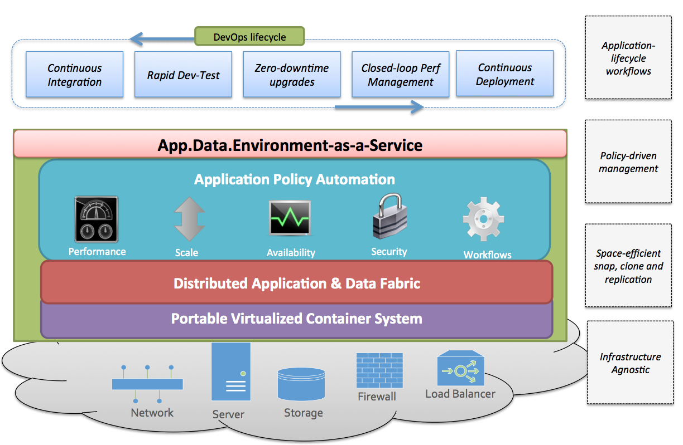
DevOps
UST’s DevOps platform accelerates the complete microservices delivery pipeline
UST DevOps Platform
Speeds up microservices development & delivery
Empowers developers & testers with self-service capabilities to create virtual environment clones
Removes complexity around environment provisioning
Enables automation at and below the level of the application stack
Extends versioning & branching capabilities to infrastructure & databases
DevOps is key to enabling continuous delivery of applications/microservices
To fully realize the potential of DevOps, databases & infrastructure need to be virtualized together with code using versioning and branching capabilities

Slide 30


DevOps Platform Difference
Benefits
App.Data.Env-as-a-Service
INFRASTRUCTURE
EFFICIENT
Virtual Clones
Lab Governance
REFRESH DEV-TEST INSTANCES
Instant Refreshes
UNIVERSAL COVERAGE
Clouds, Hypervisors and DBs
NEARLY INSTANT AUTOMATED PROCESS
Automated Workflows
SELF SERVICE
Role-Based Delegation & Control

Slide 31
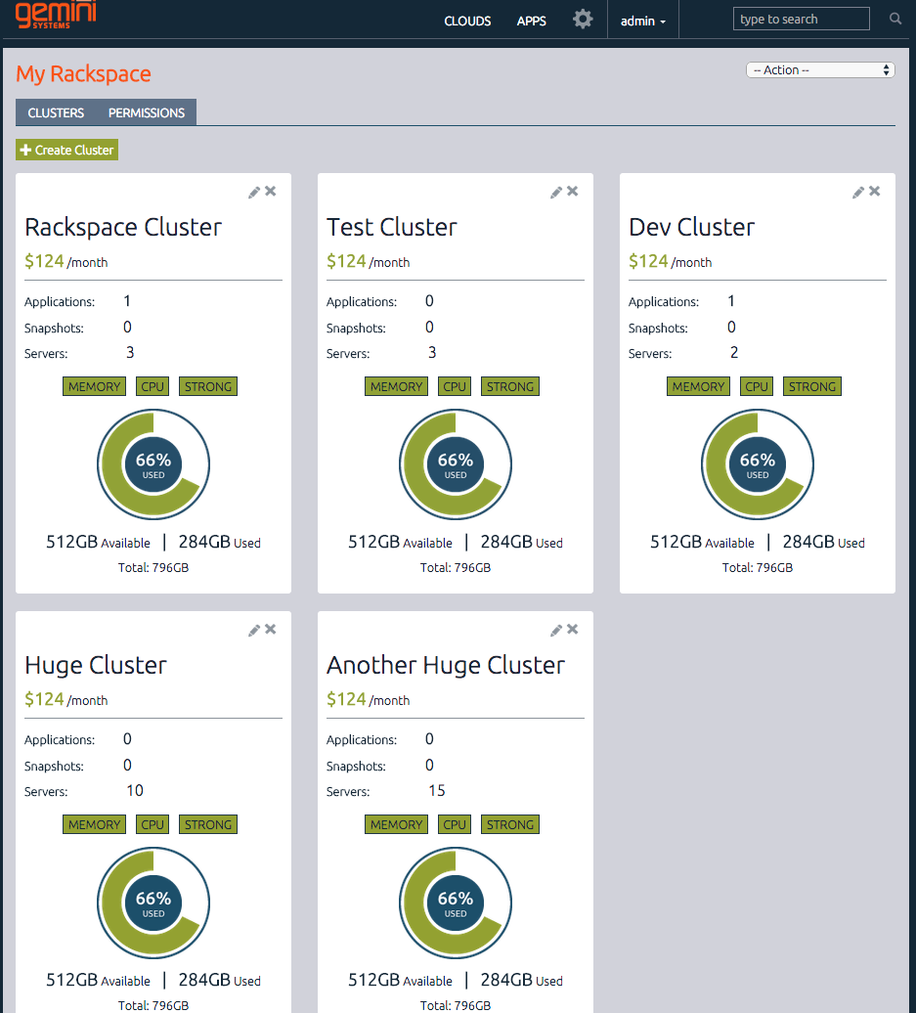
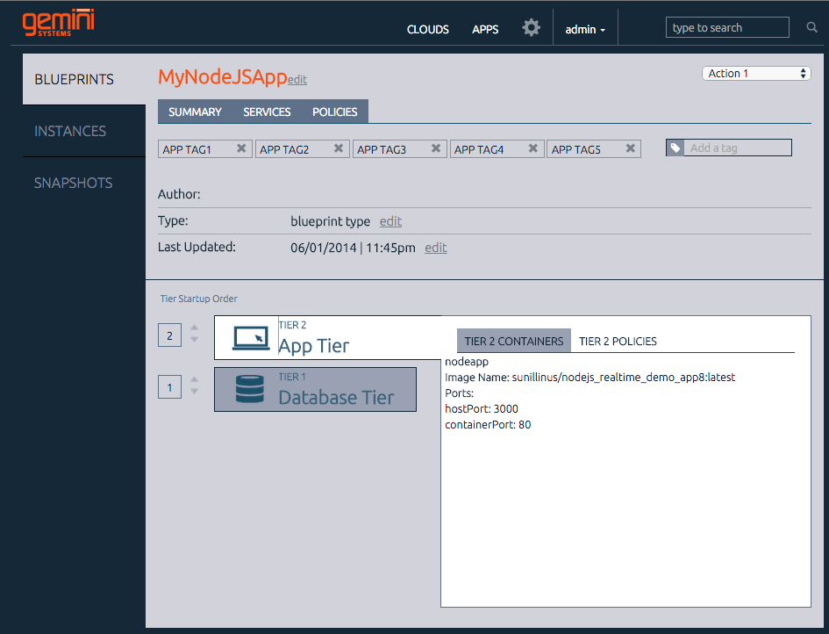
Simple yet Powerful System
Product
Empowers enterprises to develop and test next-generation applications with unprecedented ease of use and efficiency to achieve accelerated time-to-market and drive down infrastructure costs
Notes:
$ saved has to
DevOps

Slide 32
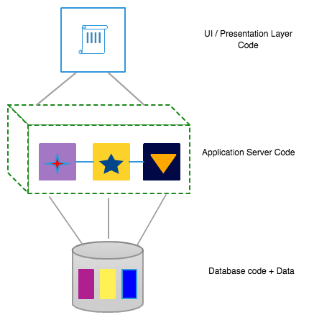
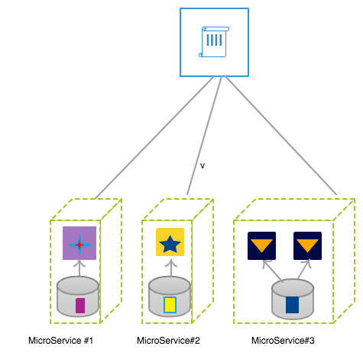
A Large Video Game Company
Case Study
Need: Accelerate billing app time to market
Challenges:
Multiple app team caused log jam at integration testing
Couldn’t test apps at scale
Expensive environment setup and teardown
Solution:
Env-as-a-service for self-serviceable environments
Microservices based architecture embedded within Gemini with versioning and AppData Clones
Multiple dev/qa streams in parallel at scale with efficient environment backend

Slide 33
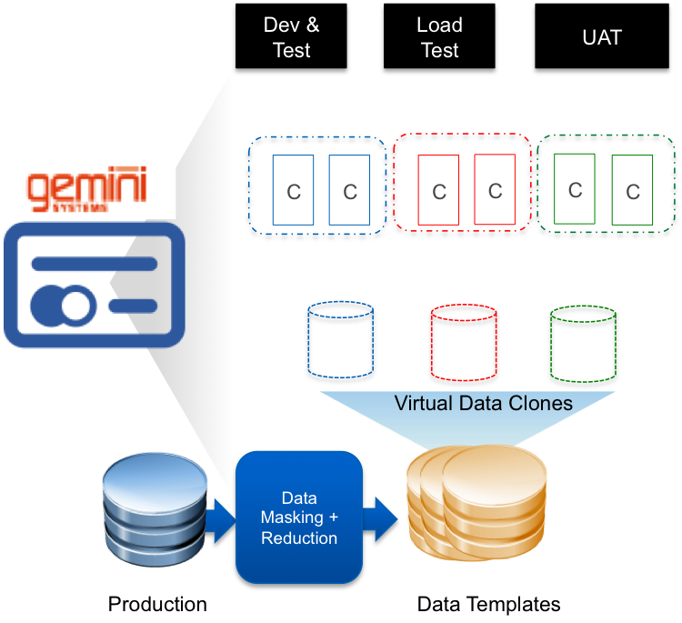
Large Media/Theme Park/Studio Company
Case Study
Need: Accelerate time to market Ticketing App
Challenges:
Could not release new features on time
Applications could not be tested at scale for peak season ticketing
Environment setup delays for Scale and System Tests
Solution Benefits:
Reduced database infra. spend by 80%
Slashed environment setup time by 20%
Higher quality releases

Slide 35
Anthem SOA Strategy Recap

Slide 36
Business Drivers & Current Challenges
Business Drivers
Enable inter-business systems and external application providers to participate in the Healthcare Marketplace.
Become easier to do business with, by developing and promoting a self-service, efficient and agile SOA delivery model by partnering with customers & providers.
Ensure that SOA solutions are stable and highly available.
Provide means for reliable and secure information exchange, reducing costs through the use of common information semantics and improved service re-use.
Provide greater agility
Shorten time-to-value
Reduce TCO - decrease level of effort for steady state (maintenance, bug fixes, performance, etc.)
Current Challenges
Large portfolio of services maintained and supported on separate release cycles
Growing complexity leading to
higher defect rates
Increased infrastructure and network usage costs
Point-to-point app/service integrations (limited reusability)
Consumers of services have to build and support business logic

Slide 37
Anthem SOA Strategy
Smaller portfolio of business-focused services
Reduce IT spend and simplify integration for online users.
Create a simplified, scalable, highly available SOA platform
Add API Management capabilities (Apigee)
Agile service delivery model for APIs and services.
Leverage Service Virtualization to promote parallel development and testing of services, accelerating delivery of business solutions while aiding in continuous testing.
Improve maturity around SOA lifecycle management
SOA lifecycle management
SOA portfolio management
Overall SOA architecture enforcement
Standardized, simplified, flexible, extensible data stores
Isolate ripple effects of changes
Promote better scalability.
SOA platform simplification
ESB rationalization & consolidation
Consolidate & upgrade legacy systems
Improve SOA infrastructure
Consolidate and expand caching infrastructure
Consolidate GPC infrastructure into enterprise SOA
Reuse current security models for accessing services
Implement new security patterns (OAuth) to support a RESTful service model

